Slide 1


Data model of the English Premier League (with neo4j)
The Department for information media and design
Advanced Information Systems
Team
Akash
Meghana
Omar
Sanketh

Slide 2
Content
Introduction
Project overview
Deep diving into data model
Scalability and Future scope

Slide 3
Introduction and Overview
English premier league is annually played.
1
Each team has a match in both, home and away ground with every other team.
2
At the end of the season the club with the most amount of points win the league.
3
All the parameters are in compliance with European football rules.
4

Slide 4
Tasks Allocation
Member\Role | Data Modeling | Neo4j Engineering | Testing And Improvement | Reporting And Presentation
Omar | R | C | C | I
Akash | C | R | C | I
Meghana | C | C | R | I
Sanketh | I | C | C | R
R – Responsible, I – Informed, C – Consulted

Slide 5
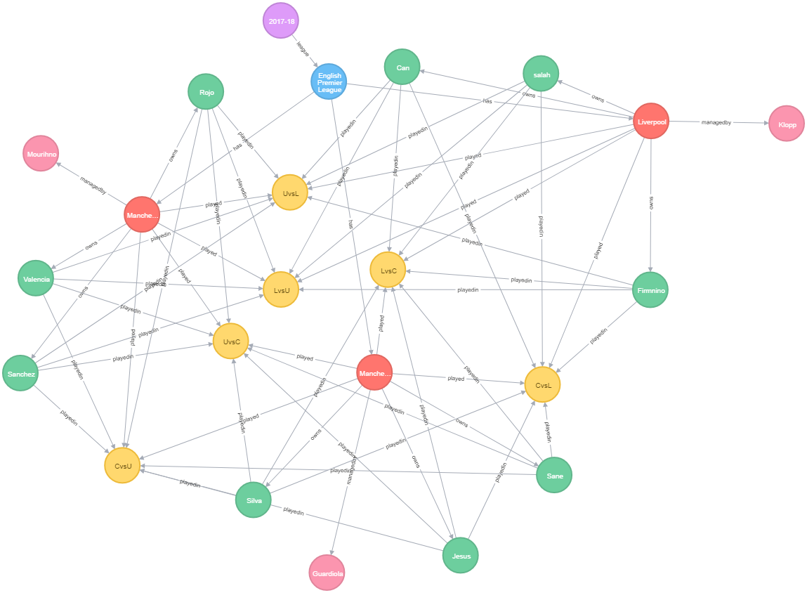
Graph Overview

Slide 6
Deep Diving
Relationship b/w Club and Match
1
Relationship b/w Club and Player
2
Relationship b/w Player and Match
3
Single use case with all nodes
4

Slide 7

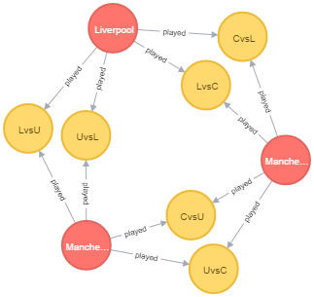
Relationship b/w Club and Match
Attendance
Win
Loss
Draw
Clean sheets
Possession
Goal
Week id
Name

Slide 8
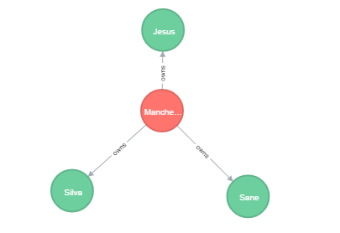
Relationship b/w Club and Player
Name
Age
Club name
Agent
Speed
Strength
Shot Accuracy
Pass Accuracy
Injuries In Season
Position
Possiblepositions
Previous teams
Name

Slide 9
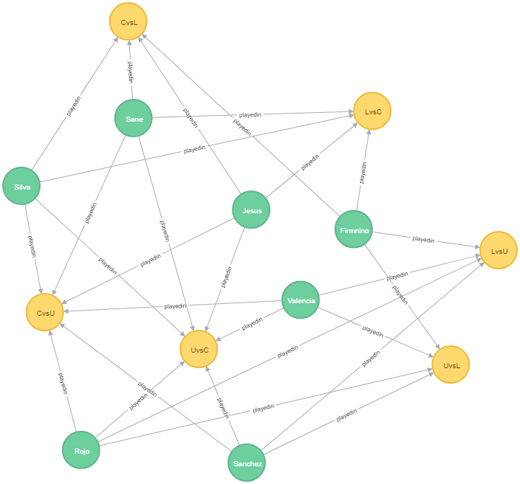
Relationship b/w Player and Match
Assists
Minutes played
MOTM
Position played
Red card
Yellow card
Fouls
Goals

Slide 10
Scalability and Future Scope
For addition of every club we have to ensure there are (N-1)*2 match nodes and a relationship between club and match. N being total number of clubs.
Addition of matches is completely based on the addition of club, ensuring of relationship is mandatory
The designed data model can be executed for any number of player, club and matches.
The data model can be designed for a more deductive analysis. For e.g. Which clubs that topped the charts before Christmas, also won the season?
Testing of this model for more number of seasons, clubs and players
Research on user stories. For e.g. what is the kind of stats the fans are currently demanding based on the season.

Slide 11
Thank You

